Slide 1












Banking System
Made by –
Rushil Adkane (RA2211026010260)
Rudraksh Agarwal-(RA2211026010274)
Dev Lodhia (RA2211026010276)

Slide 2
ABSTRACT
In today's digital age, banking systems have become an indispensable part of our lives. These systems provide a secure and convenient way to manage our finances, making them essential for both individuals and businesses. This project aims to develop a simple banking system using Python, SQLite3, and Tkinter. The system will allow users to create accounts, deposit and withdraw money, and check their balance. The system will be designed with a user-friendly graphical interface (GUI) using Tkinter, making it easy to use for people of all ages and technical abilities.

Slide 3
INTRODUCTION
Banking systems play a crucial role in modern society, facilitating financial transactions and managing money. However, complex banking systems can be difficult to use for individuals with limited technical expertise. This project aims to develop a simplified banking system that is easy to understand and operate, catering to a wider audience.
The primary objective of this project is to create a functional banking system that offers essential banking services, including account creation, deposits, withdrawals, and balance inquiries. The system should be user-friendly and accessible to individuals with varying levels of technical knowledge.

Slide 4
Problem Statement
Existing banking systems often involve complex interfaces and intricate procedures, making them challenging for non-technical users. This project addresses this issue by developing a simplified banking system that prioritizes ease of use and accessibility.

Slide 5
Challenges
Data Security: Ensuring the security and confidentiality of user data is paramount.
Usability: The system should be intuitive and easy to navigate for users of all levels of technical expertise.
Database Management: Efficiently managing customer data and transaction records is essential for the system's functionality.
.

Slide 6
Functional Requirements: Account Creation: The system should allow users to create new accounts by providing their personal information. Deposit Funds: Users should be able to deposit funds into their accounts. Withdraw Funds: Users should be able to withdraw funds from their accounts, ensuring sufficient balance. Balance Inquiry: Users should be able to check their account balance. Non-Functional Requirements: User Interface: The system should have a user-friendly and intuitive graphical interface. Data Security: User data should be securely stored and protected from unauthorized access. Database Performance: The system should be able to handle a significant number of users and transactions without performance degradation.

Slide 7
ARCHITECTURE AND DESIGN
The proposed banking system application will employ a client-server architecture. The client-side application will be developed using Tkinter GUI and will communicate with the server-side application through a secure communication channel. The server-side application will be responsible for managing customer data, transaction records, and database operations.
The server-side application will be developed using Python and SQLite3. SQLite3 will be used to store and manage customer data and transaction records.
The client-side application will be developed using Tkinter GUI. Tkinter will be used to create a user-friendly interface that allows users to interact with the banking system application. The client-side application will communicate with the server-side application through a secure communication channel, such as TCP sockets or web services.

Slide 8
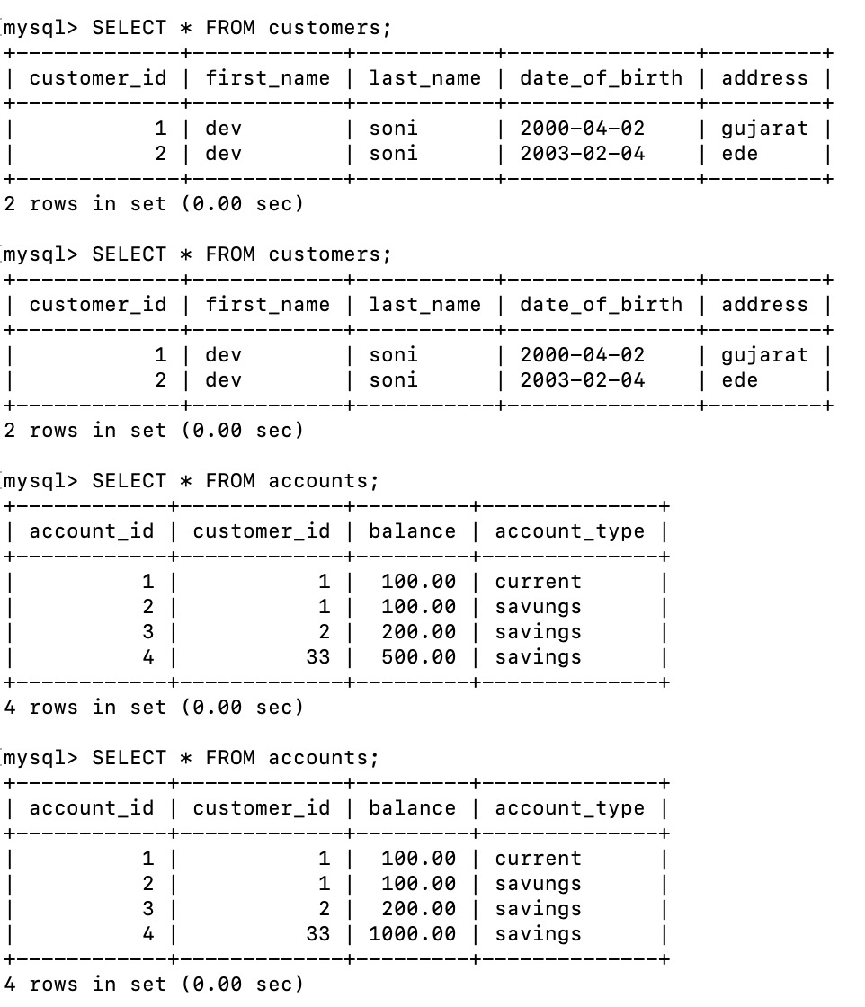

Slide 9
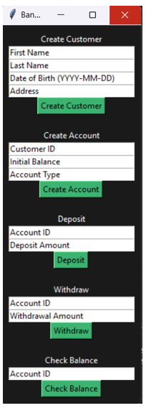
RESULTS

Slide 10


CONCLUSION
The proposed simple banking system application aims to provide basic banking functionalities, including customer creation, deposit, withdrawal, and balance checking. The application will utilize Python, SQLite3, and Tkinter to ensure security, reliability, and user-friendliness. The application will address the limitations of traditional banking methods by providing an accessible and convenient way to manage finances.

Slide 11
Thank You!

